Slide 1
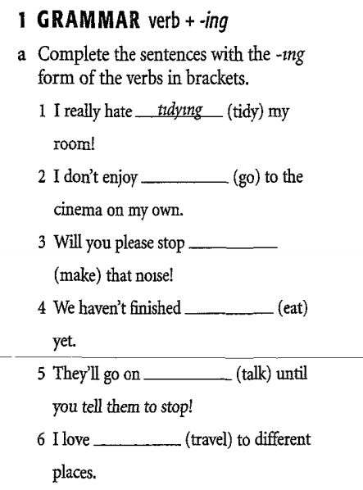
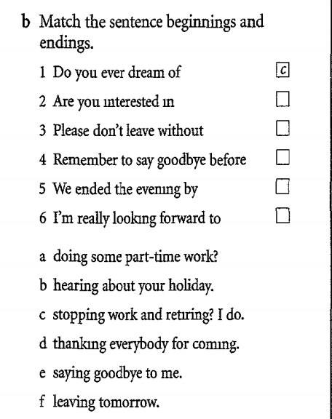

Slide 2
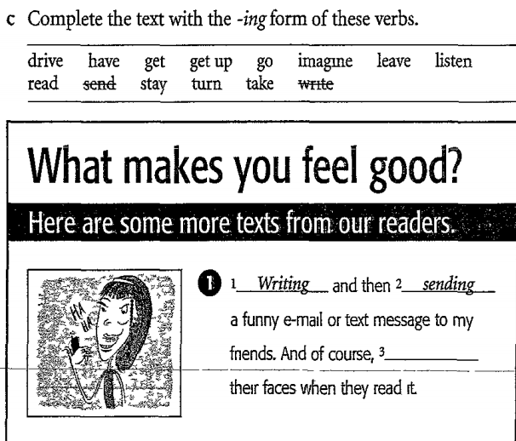
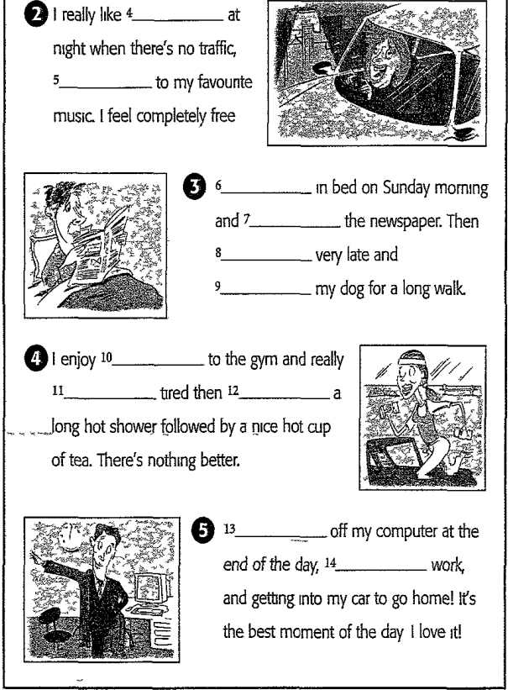

Slide 3
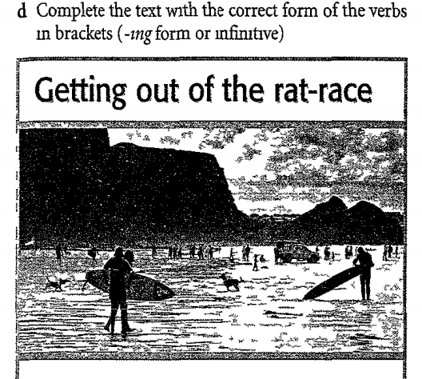
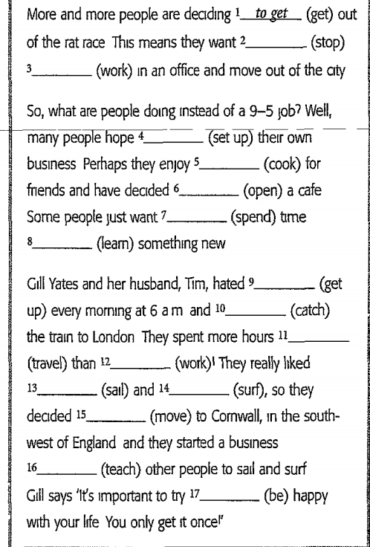

Slide 4
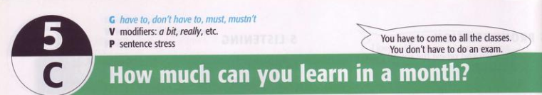
* Mục đích: Provide students:
+ Grammar: have to, don’t have to, must, mustn’t
+ Vocabulary: modifiers: a bit, really, etc…
+ Pronunciation: sentence stress
* Yêu cầu: After lesson, students can:
+ Understand and apply have to, don’t have to, must, mustn’t
+ Practice 4 skills: listening, speaking, reading and writing

Slide 5
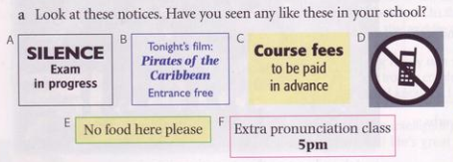
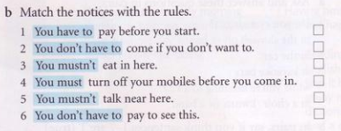
1. GRAMMAR: have to, don’t have to, must, mustn’t
C
F
E
D
A
B

Slide 6
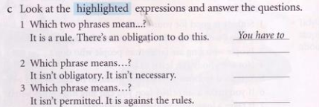
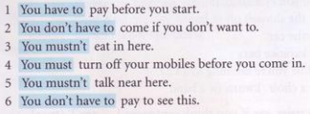
You must
You don’t have to
You mustn’t

Slide 7
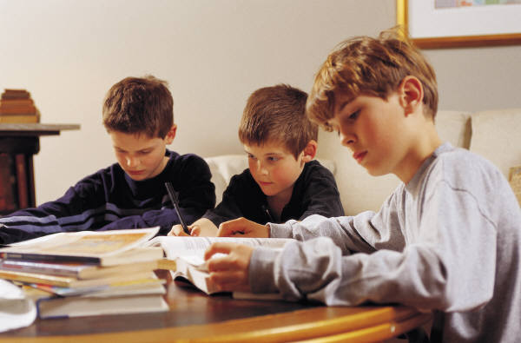
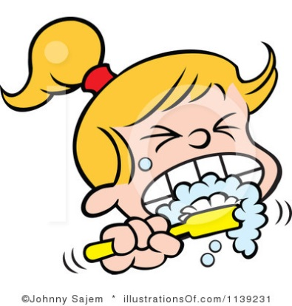
Uses of have to, don’t have to
Use have to + infinitive to talk about rules and obligations, or to say something is necessary in the present or future.
Ex: The boys have to study hard.
She has to brush her teeth everyday

Slide 8
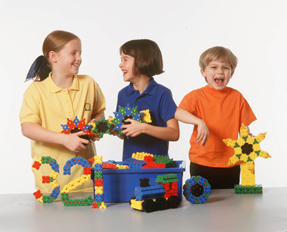
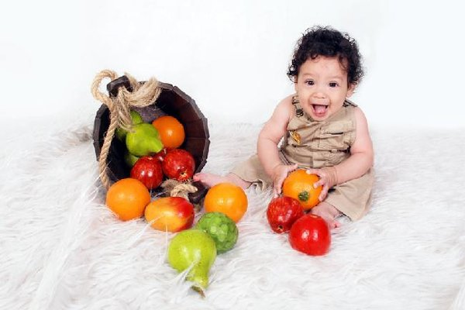
Use don’t/doesn’t have to + infinitive to say there is no obligation, or something is not necessary to do.
Ex: The children don’t have to go to school today. It’s Saturday!
She doesn’t have to eat all the fruits.

Slide 9
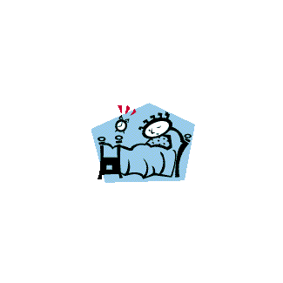
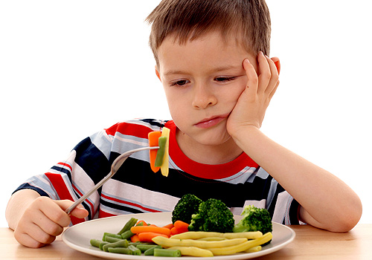
Use do/does to make questions and negatives.
He doesn’t have to get up early on Sundays
Does he have to eat the vegetables?
Yes, he does/ No, he doesn’t

Slide 10
FORMS:
(+) S + have to/ has to + verb + complement
I / you/ we / they
Have to
She/ he / it
Has to
(-) S + don’t/ doesn’t have to + verb + complement
I / you/ we / they
Don’t have to
She/ he / it
Doesn’t have to

Slide 11

(?) Do/does + s + have to + complement?
Do
I/ you/ we/ they have to…?
Does
He/ she/ it have to…?
NOTE:
Don’t contract have or has.
Ex: I have to go. NOT I’ve to go

Slide 12
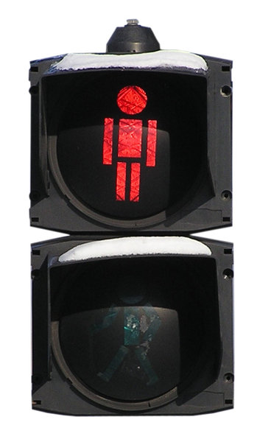
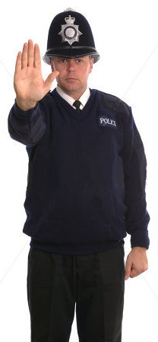
Uses of must, mustn’t
You must stop here.
Use must + infinitive to talk about rules and obligations.
You mustn’t cross the street now.

Slide 13
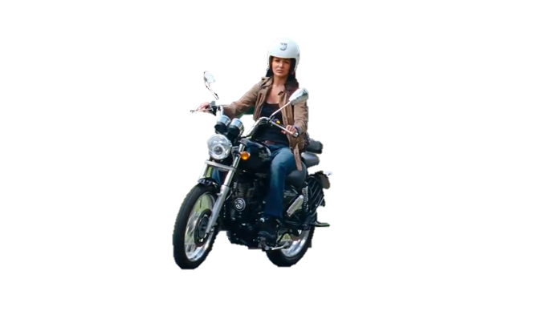

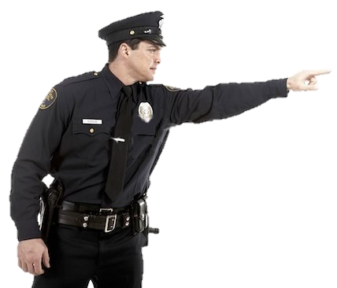

Must and mustn’t are the same for all persons. It is not often used in questions (have to is more common).
She must wear a helmet.
He must do his homework.

Slide 14
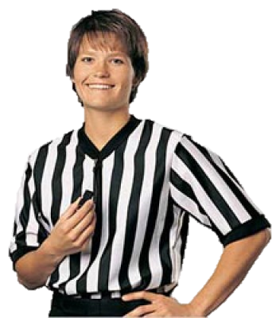

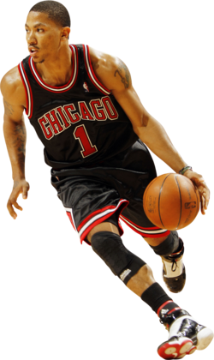
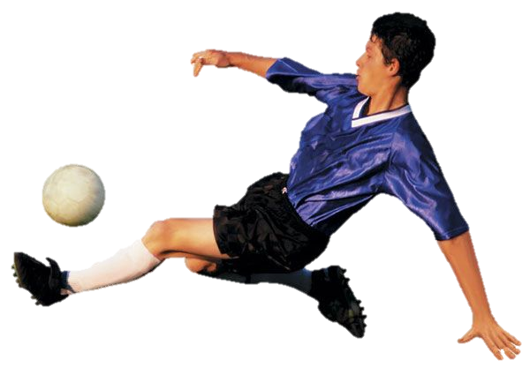
Use mustn’t + infinitive to say something is prohibited.
You mustn’t touch the ball with your hands
He mustn’t kick the ball.

Slide 15
You can use mustn’t or can’t to talk about rules.
Ex: Mustn’t park here. You can’t park here.
FORMS:
(+) S + must + V
(-) S + must not + V
(= mustn’t)

Slide 16
Notes:
Must and have to are very similar, but there is a small difference. We normally use have to for a general obligation (a rule at work or a law). We normally use must when the speaker imposes the obligation (For exmple, a teacher to students or parent to children). But often we can use either.
Mustn’t and don’t have to have completely difference meanings. Compare:
You mustn’t go = You can’t go. It’s prohibited.
You don’t have to go = You can go if you want but
it’s not obligatory/ necessary.

Slide 17
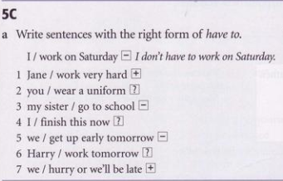
Exercises
Jane has to work very hard
Do you have to wear an uniform?
My sister doesn’t have to go to school
Do I have to finish this now?
We don’t have to get up early tomorrow
Does Harry have to work tomorrow?
We have to hurry or we’ll be late

Slide 18
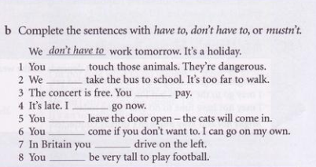
mustn’t
have to
don’t have to
have to
mustn’t
don’t have to
have to
don’t have to
https://quizizz.com/admin

Slide 19

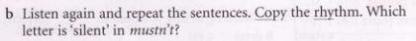
I have to wear a uniform at my school
We mustn’t be late
Do we have to do an exam?
He doesn’t have to work at weekends
You must do your homework
My sister has to travel a lot
The first “t” is silent in mustn’t

Slide 20
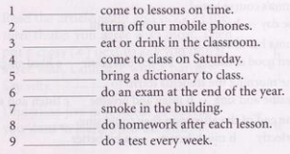
Note: In this exercise only “have to” and not “must” is used to express (+) obligations
We have to
We have to
We mustn’t
We don’t have to
We have to
We have to
We mustn’t
We have to
We don’t have to

Slide 21
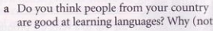
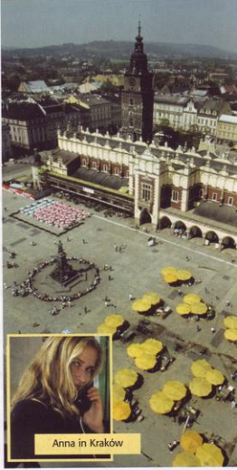
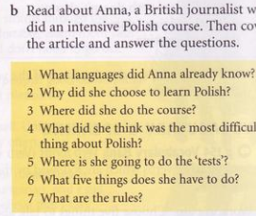
ho
ver

Slide 22
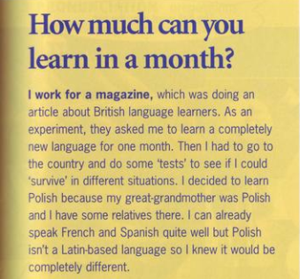
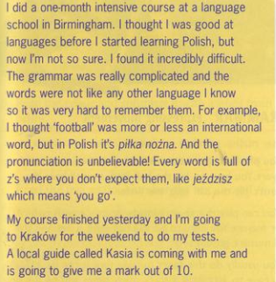
b. Read about Anna, a Britist journalist who did an intensive Polish course.

Slide 23
Answer the questions:
What languages did Anna already know?
Why did she choose to learn Polish?
Where did she do the course?
What did she think was the most difficult thing about Polish?
Where is she going to do the ‘tests’?
What five things does she have to do?-
What are the rules?
- French and Spanish
- Because her great-grandmother was Polish and she has relatives in Poland
- At a language school in Birmingham (UK)
- Grammar and pronunciation
- In Kraków
- Get a taxi, order a drink in a bar, ask for direction and follow them, phone and ask to speak to someone, ask somebody the time.
- She mustn’t use a dictionary or a phrasebook, or speak English, or mime or use her hands

Slide 24
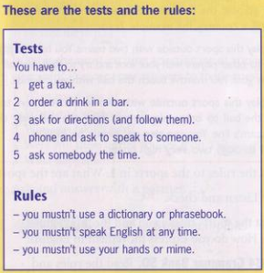
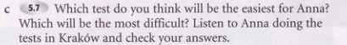
The easiest test for Anna was probably getting a taxi
The most difficult was asking for directions

Slide 25
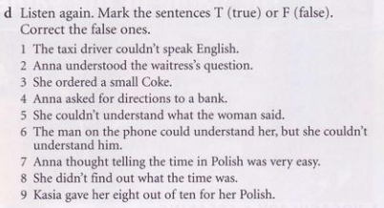
F His English was perfect
T
F She ordered a big beer
F She asked for direction to the chemist’s
T
T
F She knew it was difficult
F She did because she asked the man to show her his watch
F Kasia gave her 5 out of ten for her Polish and 8 for imagination

Slide 26
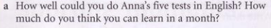
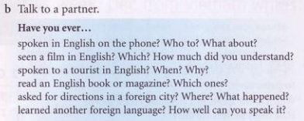

Slide 27
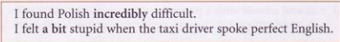
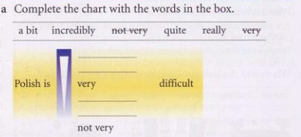
/‘mɔdifaiə/
(incredibly = very, very)
(a bit = a little)
incredibly /in’kredəbli:/
Really /’riəli/
quite
abit
Notes:
Khó tin nổi, đáng kinh ngạc

Slide 28
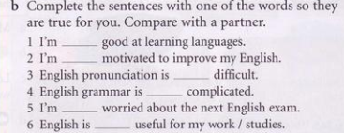

Slide 29
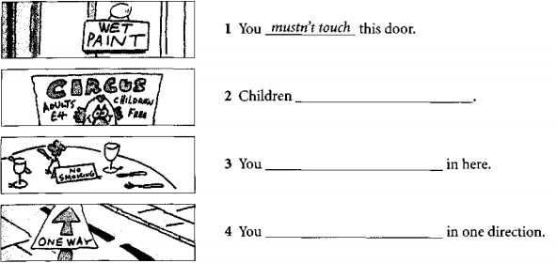
Exercises
don’t have to pay
mustn’t smoke
have to drive

Slide 30
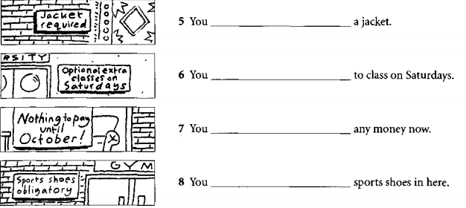
have to wear
don’t have to come
don’t have to pay
have to wear

Slide 31
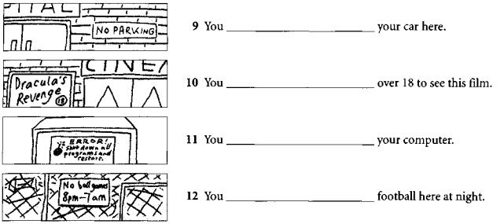
mustn’t park
have to be
have to turn off
mustn’t play

Slide 32
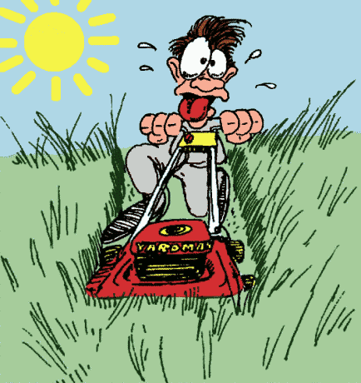

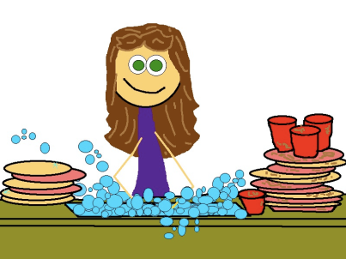
Order the following sentences.
5.- cut the grass/ Does/ have to/ he?
…………………………………………….
6.- She/ study/ has to/ everyday.
……………………………………….
4.- do the dishes/ has to/ she.
…………………………………….

Slide 33
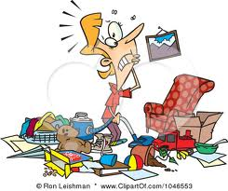
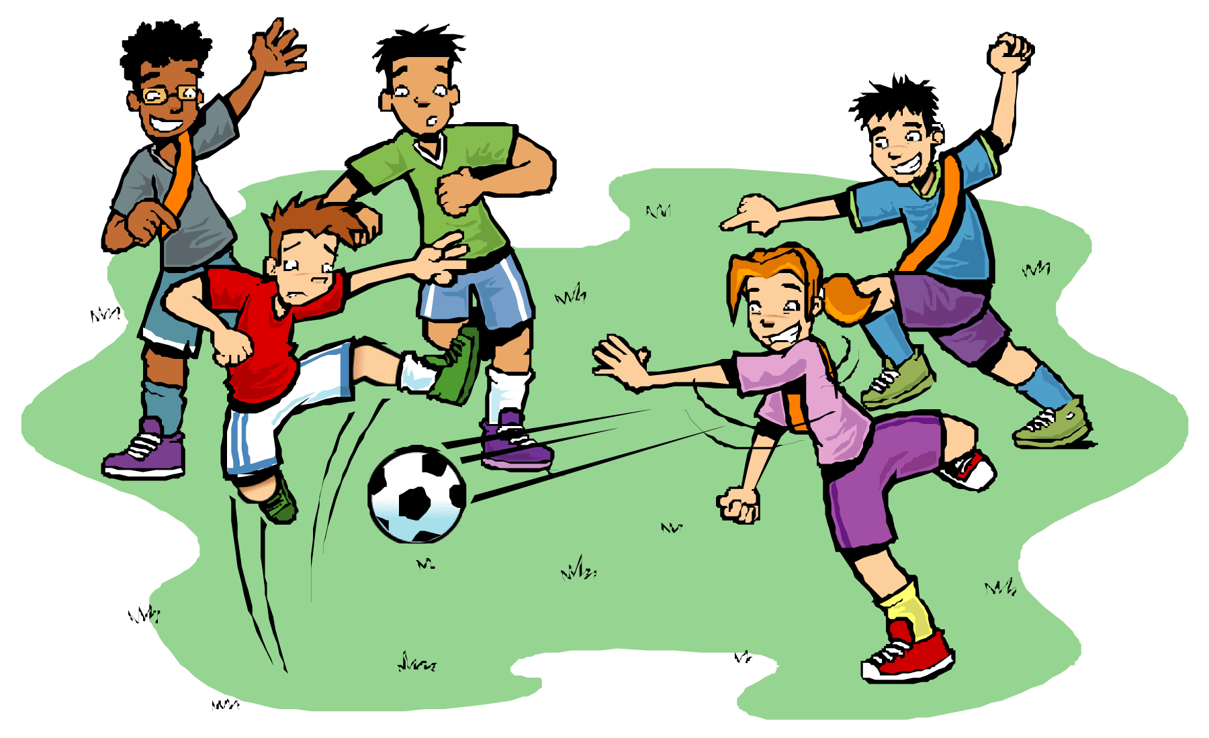
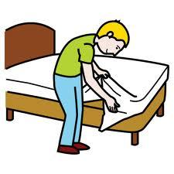
Order the following sentences.
1.- clean your room/ have to/ you.
…………………………………….....
2.- they/ play football/ Do/ have to ?.
…………………………………………
3.- don’t have/ I/ make my bed.
……………………………………

